Slide 1
Encoders

Slide 2
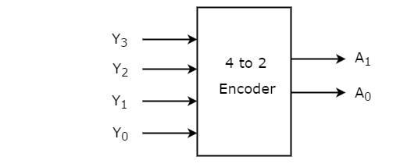
Encoders
Performs the inverse function of a Decoder.
Converts input code words (2^{n}) into n output code words.
Application: 8 to 3 bit encoder can be used as Octal to Binary Convertor

Slide 3
8 to 3 bit Binary Encoder
I0
2^n-to-n encoder : 2^n inputs and n outputs.
Input code : 1-out-of-2^n.
Output code : Binary Code
Example : n=3, 8-to-3 encoder
Inputs Outputs
I0 I1 I2 I3 I4 I5 I6 I7 Y2 Y1 Y0 1 0 0 0 0 0 0 0 0 0 0 0 1 0 0 0 0 0 0 0 0 1 0 0 1 0 0 0 0 0 0 1 0 0 0 0 1 0 0 0 0 0 1 1 0 0 0 0 1 0 0 0 1 0 0 0 0 0 0 0 1 0 0 1 0 1 0 0 0 0 0 0 1 0 1 1 0 0 0 0 0 0 0 0 1 1 1 1
I1
I2
Y0
I3
Y1
I4
Y2
I5
I6
I7
Binary encoder

Slide 4
8-to-3 encoder Implementation
Simplified implementation: - From the truth table Y0 = I1 + I3 + I5 + I7 Y1 = I2 + I3 + I6 + I7 Y2 = I4 + I5 + I6 + I7
Limitations : - I0 has no effect on the output - Only one input can be activated
Application: Handling multiple devices requests But, no simultaneous requests
Establishing priorities solve the problem of multiple requests
I0
Y2
I1
I2
I3
Y1
I4
I5
I6
Y0
I7

Slide 5
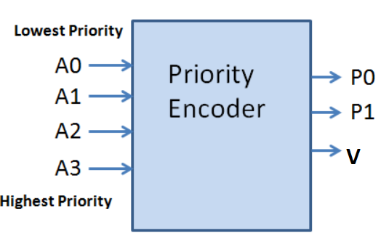
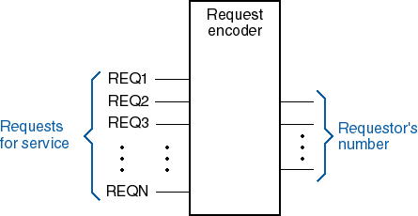
Priority Encoder
4-bit priority encoder
A₃ has the highest priority, A₀ least
Valid bit indicator that is set to 1 when one or more inputs are equal to 1.
Notes:
If all inputs are 0, there is no valid input and V is equal to 0.
The other two outputs are not inspected when V equals 0 and are specified as don’t-care
conditions.

Slide 6
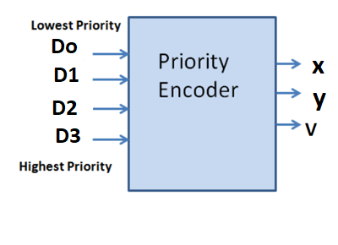
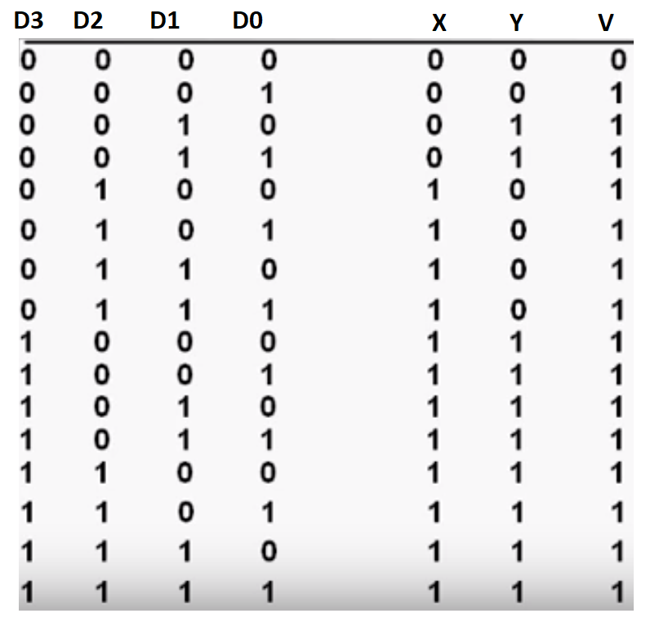
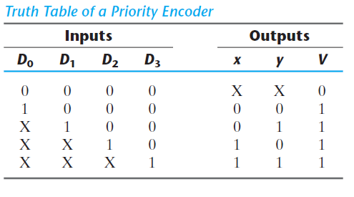
Design of 4-input Priority Encoder
Notes:
In addition to two outputs x, and y, the truth table has a third output designated by V, which is a valid bit indicator that is set 1 when one or more inputs are equal to 1. If all inputs are 0, there is no valid input and V is equal to 0.
X’s in the output column indicate don’t care conditions, the X’s in the input columns are useful for representing a truth table in condensed form.
The higher the subscript number, the higher the priority of the input. Input D3 has the highest priority, so regardless of the values of the other inputs, when this input is 1, the output for xy is 11 (binary 3)

Slide 7
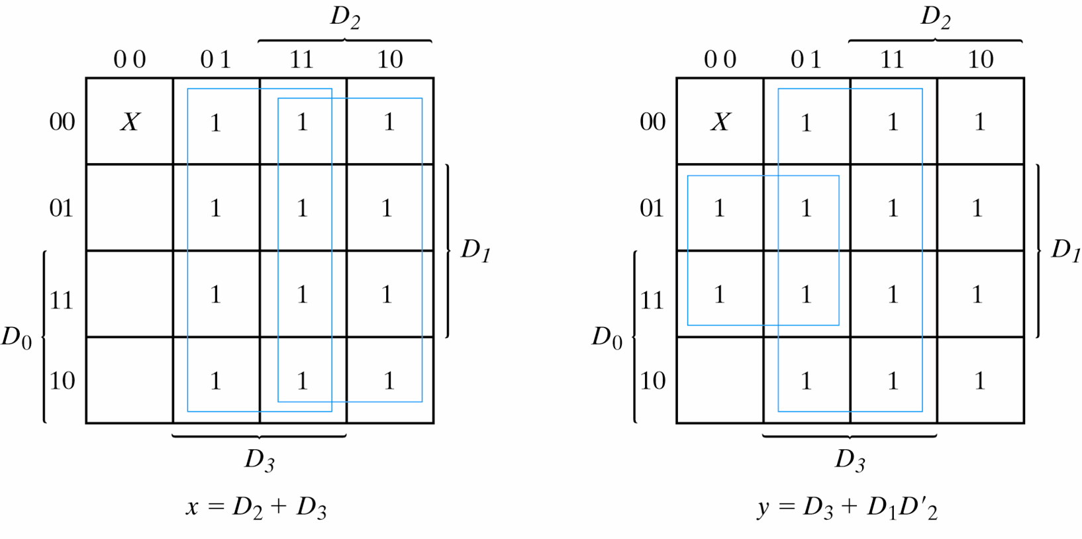
Design of 4-input Priority Encoder
V=D₀+D₁+D₂+D₃
K-Maps for 4-input Priority Encoder

Slide 8
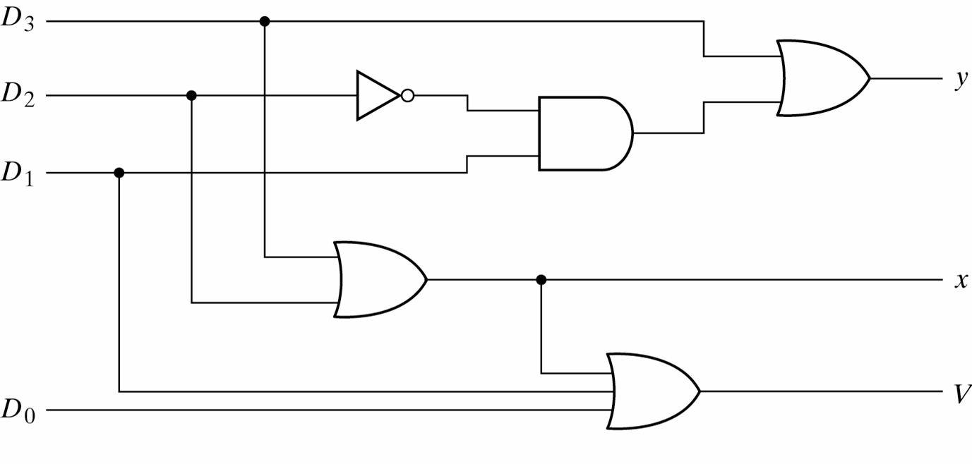
Design of 4-input Priority Encoder
Logic Diagram for 4-input priority encoder

Slide 9
Multiplexers

Slide 10
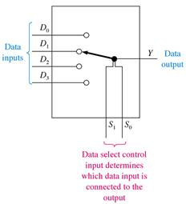
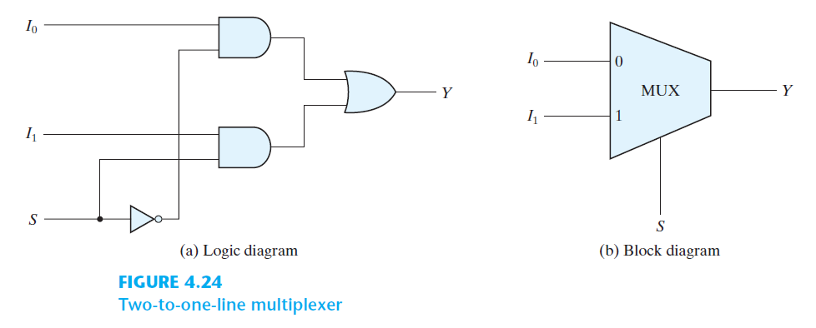
MULTIPLEXERS/DATA SELECTORS
A combinational circuit that selects one of many input lines (2^{n}) and steers it to its single output line.
Acts like an electronic Switch (Data Selector)
The selection of a particular input line is controlled by a set of selection lines. Normally, there are 2^{n} input lines and n selection lines whose bit combinations determine which input is selected.
2 : 1
Notes:
Number of input = n = 2^m where m is no of select lines.

Slide 11
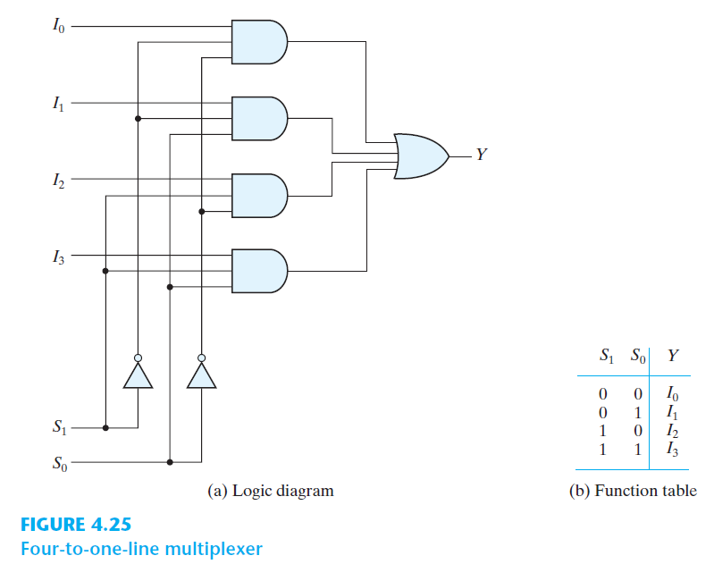
4-to-1LINE MULTIPLEXER DESIGN

Slide 12
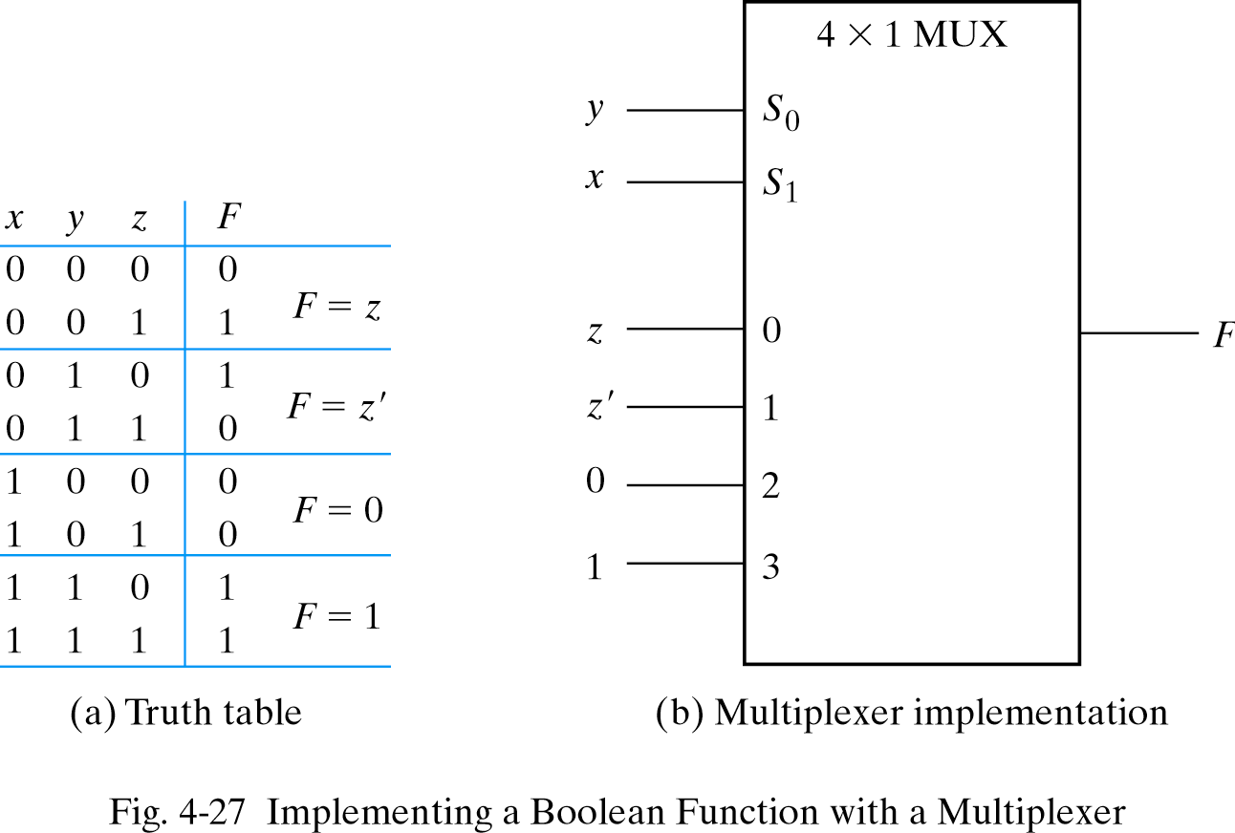
Function implementation using multiplexers
Function with n variables and multiplexer with n – 1 selection
Input variables x, y: Selection lines, S₁ and S₀
Variable z: Date line 0
Data lines 1,2,3:
Notes:
*for info*

Slide 13
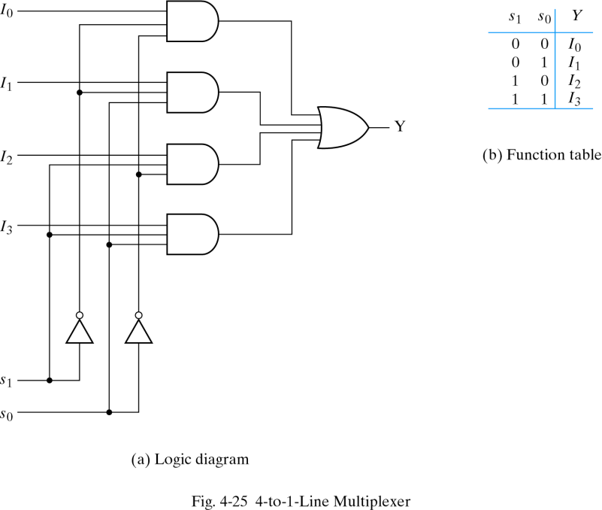
Function implementation using 4x1multiplexer
z
z’
0
1
x
y
Notes:
*for info*

Slide 14
Function implementation using 8x1multiplexer
Complete the truth table from the SOP.
The first n – 1 variables in the table are applied to the
selection inputs of the multiplexer.
For each combination of the selection variables, we evaluate
the output as a function of the last variable.
4. Apply these values to the data input in proper order.
Notes:
*for info*

Slide 15
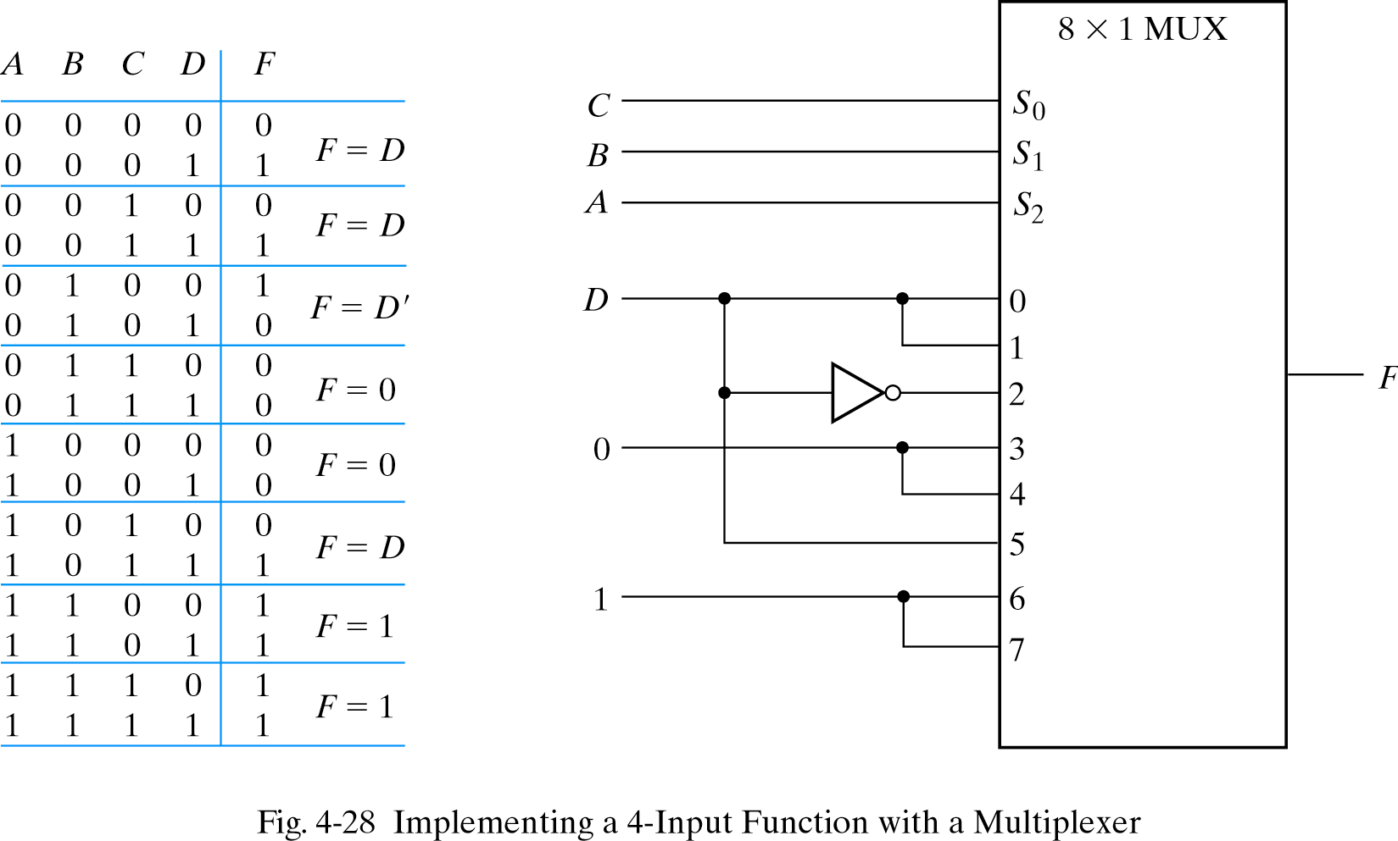
Function implementation using 8x1 MUX
note the order of input lines
Notes:
*for info*

